Slide 1
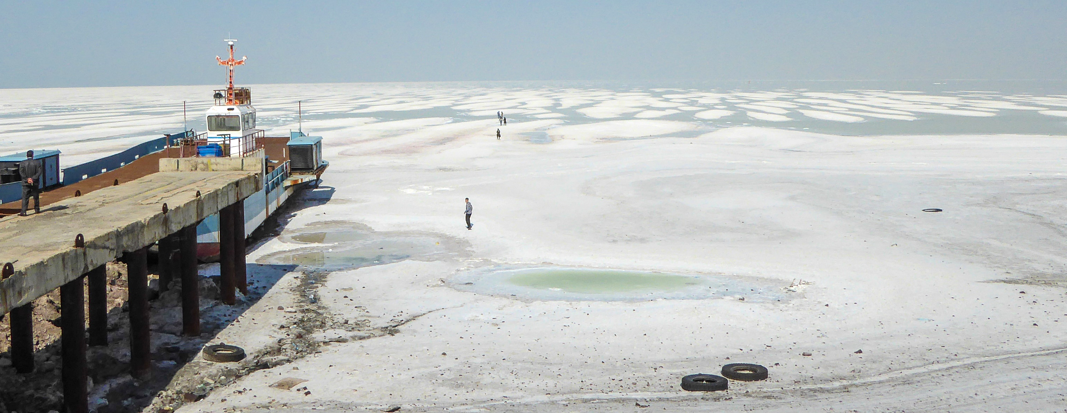
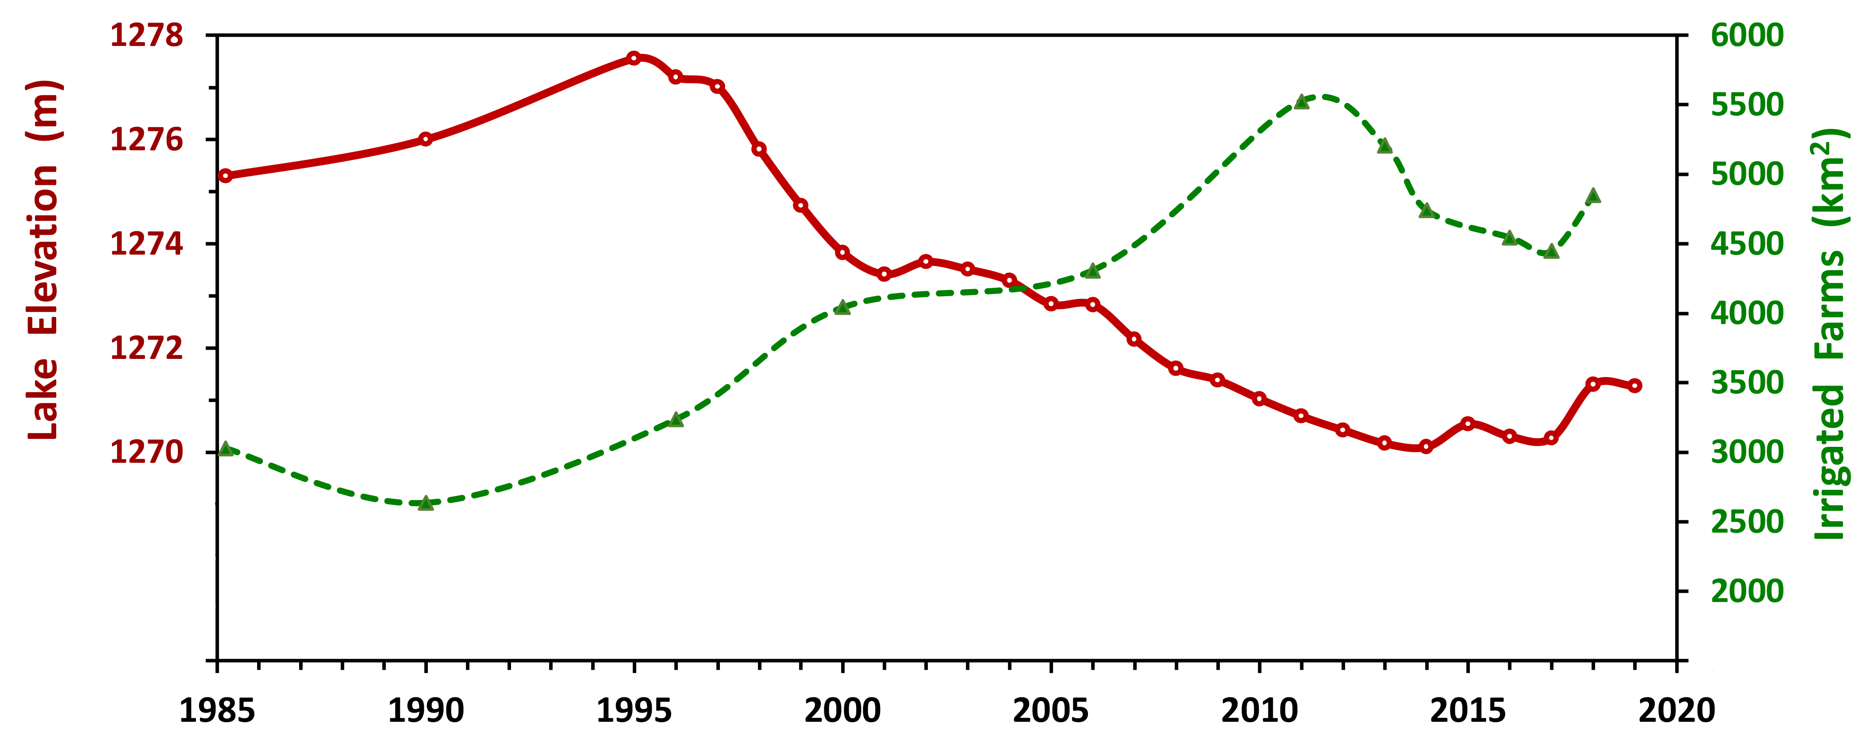

Lake Elevation─
Irrigated─
Farms
Recovery Project
Precipitation
Precip.

